Slide 1
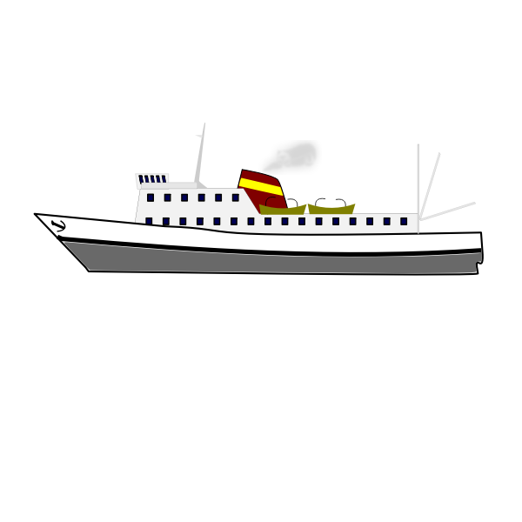
Sail to Success
With IIS/FRS

Slide 2

Smooth Sailing
We all wish life could be perfect–sunny skies, calm seas,
Notes:
and perfectly behaved children with straight A’s…

Slide 3

Storms are always on the horizon
Parenting struggles,
behavioral challenges and
poor family communication
Notes:
But…STORMS are inevitable! are a few reasons why IIS/FRS helps you
steer your family into a steadier course.

Slide 4

Intensive in-home Services/Family Reunion Services
Is a free program for ANY St. Louis City or County family
Is a crisis intervention program
Is intensive, 8 hours in the home weekly
Is designed to keep kids safe
Is designed to avoid out-of-home placement
Is short-term–45 to 90 days
Is ready to address:
  Home maintenance and organization
  Parenting and communication skill building
  Connections to community resources
Is support for any family needing services; birth, foster or adoptive

Slide 5

What do IIS/FRS specialists do?
Meet families within 24 hours of referral (up to 72 hours for FRS)
Meet with families about 3 times/week for 6 weeks (up to 90 days for FRS)
Check for family safety every 72 hours
Meet families where they are without judgment
Connect families to community resources
Provide support to families as needed with
  Educational, medical and behavioral issues
  Communication and parenting
  Home maintenance and utilities
Provide transportation to Intervention services

Slide 6

What specialists are not…
House cleaners
Taxi drivers
Magicians
Parent substitutes
Bankers
Spies
Kid removers (but we are mandated reporters)

Slide 7
How is IIS different from FRS?
IIS works to prevent kids from entering alternative care. Interventions last 6 weeks and require 8 in-person contact hours per week
FRS works to assist kids and their parents as they reunite from their time in alternative care. Interventions can last up to 90 days, depending upon the family’s progress and the courts. FRS requires 4 in-person contact hours per week.

Slide 8
What are the requirements to get IIS Services
Be a resident of St. Louis city or county
Be ANY family at risk of their kids entering alternative care (including birth families, adoptive kinship and foster families)
Be willing to regularly meet with the IIS specialist about 3 times/week, for a total of 8 hours (4 hours/week for FRS).
Be committed to making changes for the better
Be able to follow through with suggestions to meet family needs and goals

Slide 9
Does it really work?
Experienced, degreed staff
At least 90% success at keeping kids home, safely
Caring, committed and creative specialists
“ I truly appreciate all you’ve done for our family”
“Thanks for your care and support!”
“Dear Ms. Bell,
Thank you for all you’ve done for us. We have learned that it takes all of us to pitch in to help around the house.”
“Thanks for the work you did with my husband and son. You helped us make a meaningful change”
“I am going to keep on moving forward in life.”

Slide 10

How do you get IIS/FRS services?
It's easy! Sail to Success
Call 314.401.9573 Monday through Friday
8 AM till 5 PM

Slide 11
Resources

